Slide 1

Nexthikes IT Solution
MACHINE LEARNING • NLP
Disaster Tweet
Classification System
End-to-End NLP & Machine Learning Solution
PYTHON / SCIKIT-LEARN / TF-IDF / FLASK
Disaster Tweet Classification System | Data Science Project

Slide 2
01
Problem Statement & Objective
THE SIGNAL PROBLEM
Crisis feeds move faster
than manual response.
SPEED
Stream-scale triage
ACCURACY
Context-aware scoring
Real-time disaster tweets are noisy, ambiguous, and overwhelming. The system automatically separates Disaster from Non-Disaster messages so responders can prioritize credible signals.
RESPONSE
Actionable routing

Slide 3
02
System Architecture Pipeline
DATA
INGESTION
TEXT
PREPROCESSING
TF-IDF
VECTORIZATION
MODEL
TUNING
FLASK WEB
DEPLOYMENT
RAW SIGNAL
LIVE PREDICTION

Slide 4
03
Data Preprocessing & Cleaning Code
clean_text.py
DATAFRAME PREVIEW
def clean_text(text):
text = text.lower()
text = re.sub(r'https?://\S+', '', text)
text = re.sub(r'[^a-z\s]', '', text)
return ' '.join(text.split())
RAW TWEET
Earthquake ALERT!!! https://t.co/x
Watching a movie about earthquakes :)
CLEANED
earthquake alert
watching a movie about earthquakes

Slide 5
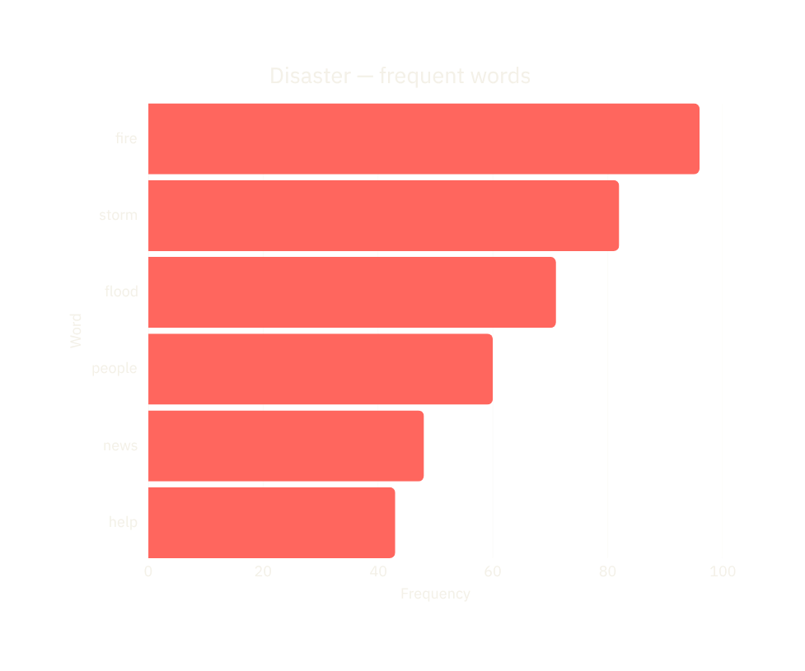
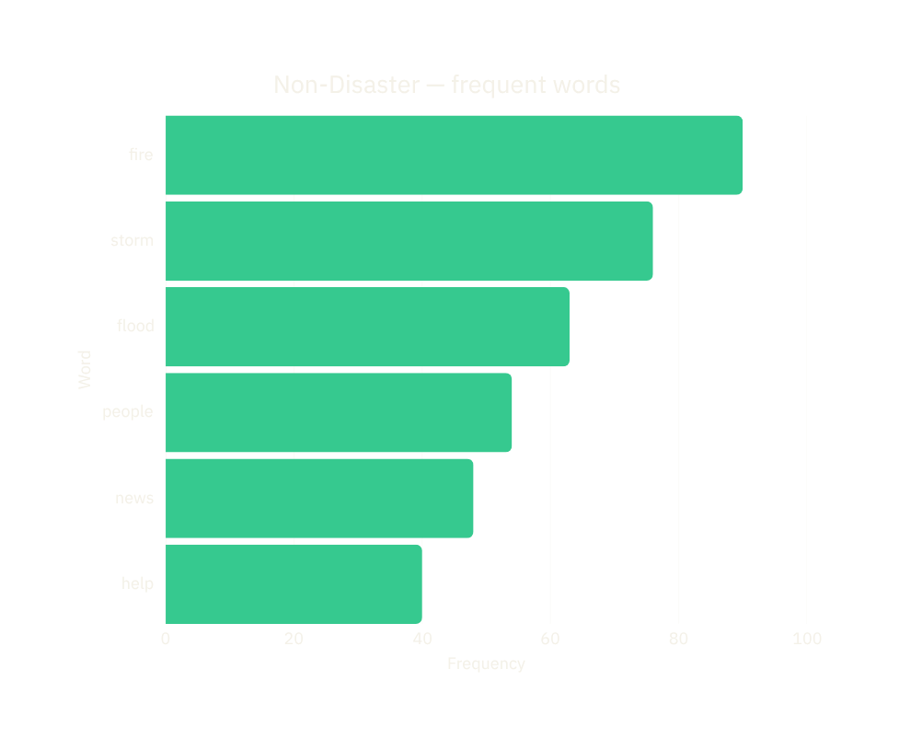
04
Exploratory Data Analysis

Slide 6
05
Feature Extraction & Baseline Models
TF-IDF turns words into weighted signals — rewarding terms that are distinctive across the corpus, not merely frequent.
MODEL
ACCURACY PRECISION RECALL F1
Logistic Regression
0.82 0.84 0.79 0.81
Random Forest
0.78 0.80 0.73 0.76

Slide 7
06
Cross-Validation & Hyperparameter Tuning
5-fold stratified cross-validation preserves class balance in every split. GridSearchCV explores regularization strength C and solver combinations.
> grid.best_params_
{'C': 3.0, 'solver': 'liblinear'}
> grid.best_score_
0.8234
CV folds 01 02 03 04 05
F1 score .81 .84 .82 .83 .82
BEST CONFIGURATION
82.3%
MEAN CV SCORE

Slide 8
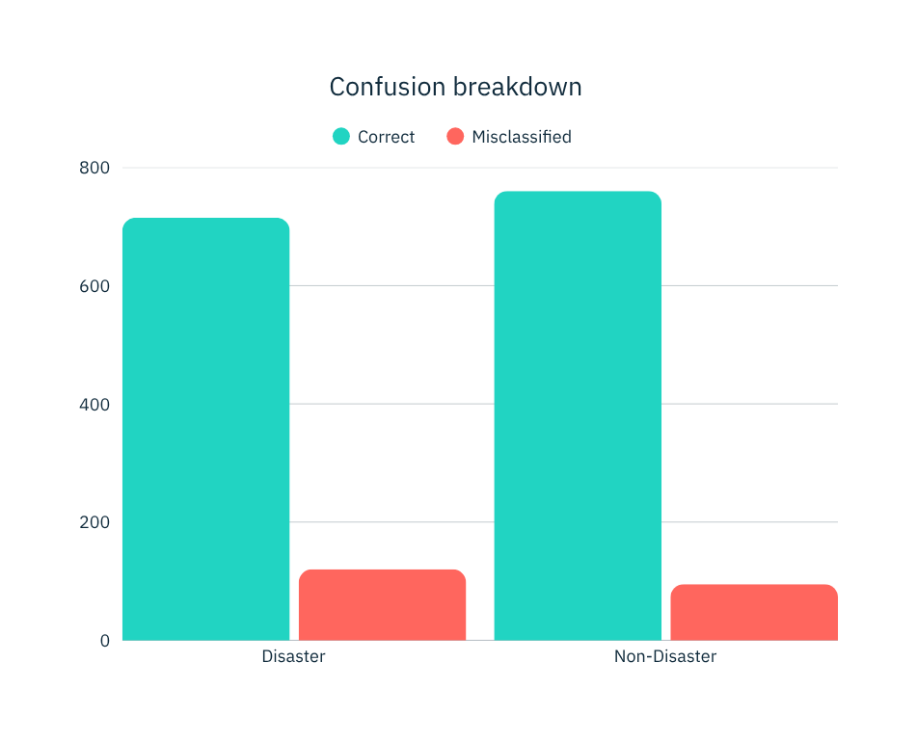
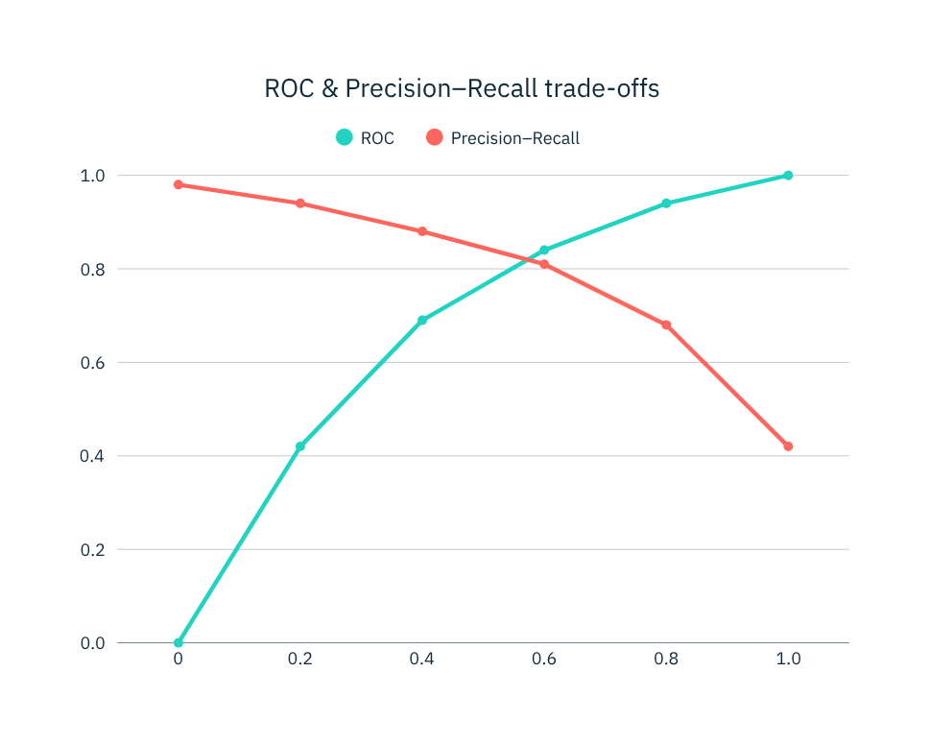
07
Model Evaluation & Visual Outputs

Slide 9
08
Model Serialization & Backend Setup
ARTIFACTS
✓ disaster_model.pkl
✓ tfidf_vectorizer.pkl
@app.route('/', methods=['POST'])
def predict():
tweet = request.form['tweet']
x = vectorizer.transform([tweet])
label = model.predict(x)[0]
return render_template(
'index.html', prediction=label
)

Slide 10
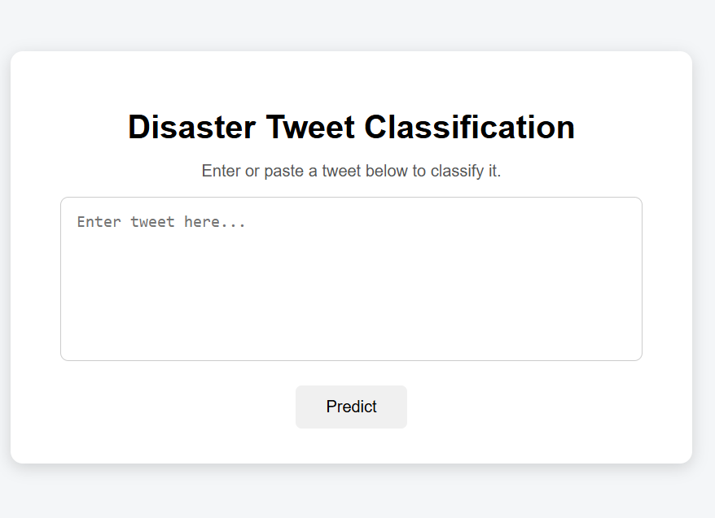
09
SIGNAL / CLASSIFIER
Web Interface Deployment Output
ENTER A TWEET
Earthquake alert in downtown
DISASTER
Confidence 91%
SIGNAL / CLASSIFIER
ENTER A TWEET
Watching a movie about earthquakes
NON-DISASTER
Confidence 88%

Slide 11
10
Conclusion & Future Scope
DELIVERED
NEXT
A complete NLP pipeline — from noisy tweet to deployed prediction.
01 Fine-tune transformer models
BERT / RoBERTa
02 Add cloud-scale deployment
AWS / GCP
03 Monitor drift and retrain
TF-IDF features • tuned Logistic Regression • serialized artifacts • Flask web interface

Slide 12

Thank
You
Presented by:
Palvinder Singh
Questions & Discussion
GitHub / Portfolio:

